Slide 1
AeroMACS Bandplan, User Community
April 22, 2015

Slide 2
AeroMACS Bandplan Discussion
Introduction & background
ITU adopted bandplan
Network reference model
Relevant standards organizations
Technical parameters for equipment – slide 8
Eligible licensees and users – slide 12
Process for authorized channel access – slide 13
Federal vs. non-federal users – slide 14
Authorized services and applications (high level) – slide 15
Other potential services
Geographical coverage limits – slide 17
Concluding remarks – slide 18

Slide 3
International Spectrum for AeroMACS
Adopted by ITU at WRC-07
AeroMACS SHALL support 5 MHz channels in the 5000 to 5150 MHz band¹
Core Band: 5091-5150
ITU WRC-07 Adopted (Co-primary AM(R)S allocation)
Supports ELEVEN 5 MHz Channels
Future (as available): 5000-5030 MHz
Provides an additional FIVE 5 MHz Channels
¹ Minimum Operational Performance Standards (MOPS) For the Aeronautical Mobile Airport Communication System (AeroMACS)
Notes:
Minimum Operational Performance Standards (MOPS) For the Aeronautical Mobile Airport Communication System (AeroMACS). This document was jointly developed by RTCA SC-223 and the European Organization for Civil Aviation Equipment (EUROCAE) WG-82 through a consensus process. It was accepted by the Council of EUROCAE and RTCA Program Management Committee.
Spectrum options for additional applications
It is worth pointing out that WiMAX/AeroMACS radios will typically cover a frequency range wider than the AeroMACS band (5000-5190). This of course is of benefit to equipment vendors in that they can manufacture one radio for multiple applications. It is better for manufacturing efficiencies and leads to higher volumes per radio type and, ultimately, lower costs.
For airport deployments it opens the possibility to use this extended frequency range capability to add other channels and applications on the same equipment. An important application that can consume significant BW is video surveillance for security applications … this could certainly be considered a ‘Public Safety’ related application for the 4940-4900 public safety band. This at present would only be applicable in the US.
The 5800 MHz WiFi band will likely be already congested, nevertheless, it may be suitable for other ‘nice to have’ applications. It would not, of course, be suitable for ‘mission critical’ applications due to the anticipated congestion. A congested channel can result in higher latency and capacity not being available when required.

Slide 4
AeroMACS Bandplan
5091 MHz
5150 MHz
59 MHz
5 MHz
5095 MHz
5145 MHz
5000 MHz
5030 MHz
30 MHz
5091-5150 MHz internationally allocated by ITU WRC-07
5000-5030 MHz identified as possible additional spectrum as available nationally
5 MHz
5005 MHz

Slide 5
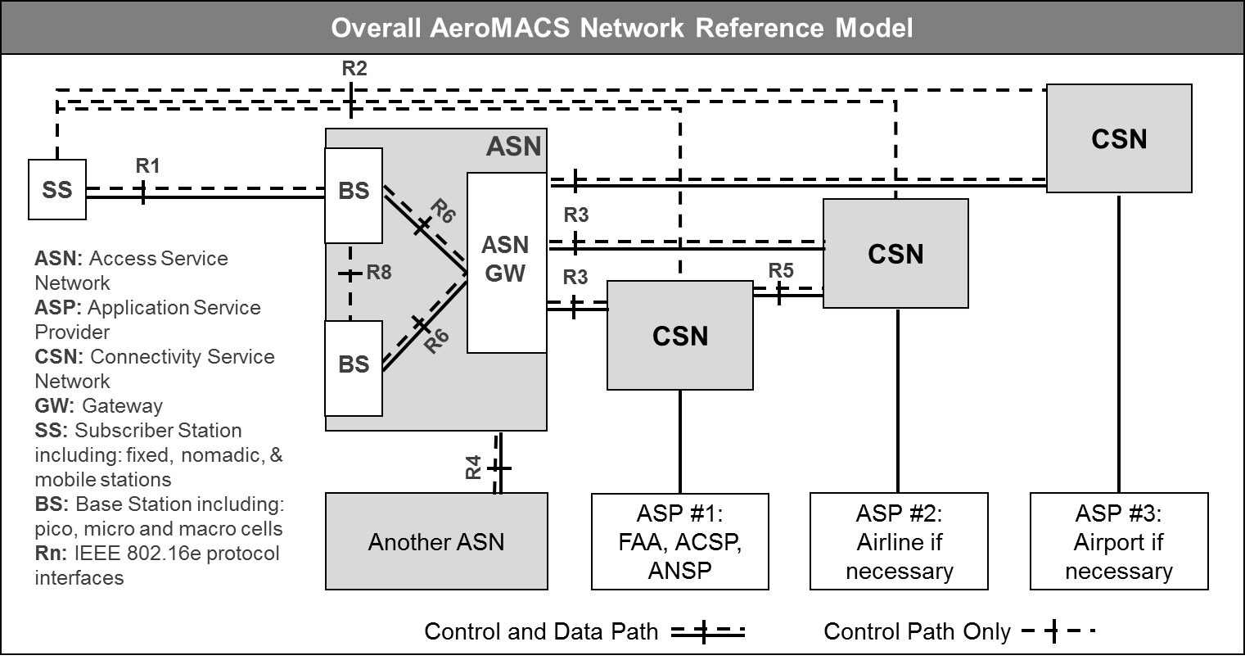
AeroMACS Airport Network
BS Backhaul comprised of wireline (fiber) and/or PtP wireless in AeroMACS band or other suitable frequency band

Slide 6
Subscriber Stations Include:
Category
Mobility Required
Aircraft (A/C)
Commercial Passenger
Commercial Cargo
Private
Equipment Pods
Multilateration pods
Weather observation pods
Airport Ground Handling Equipment (GHE)
Tow vehicles
Cargo & baggage handling
Passenger shuttles
Etc.
Authorized personnel
Handheld portable devices
Mobile
Up to 50 nautical miles per hour
Stationary
Nomadic pico-cell BSs

Slide 7
Relevant Standards Organizations
IEEE: IEEE std 802.16e-2005/9
WiMAX Forum: AeroMACS Profile
RTCA (Radio Technical Commission for Aeronautics): Minimal Operational Performance Standards (MOPS) for the Aeronautical Mobile Airport Communications
ICAO (International Civil Aviation Organization): Standards and Recommended Practices (SARPs)
EUROCAE (European Organization for Civil Aviation Equipment): - Minimum Aviation System Performance Standards (MASPs) draft

Slide 8
1. Technical Parameters
Channel BW: 5 MHz channels, 250 kHz step size
Duplexing: TDD
BS & SS EIRP Limits: ensure 2% noise threshold limit for non-geostationary satellite uplink (Globalstar) slide 9
BS Antenna Elevation slide 10
Spectral Mask (i.e. OOBE) slide 11

Slide 9
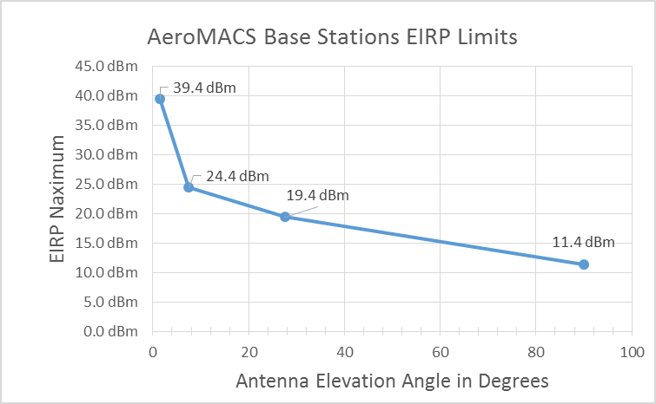
1c: BS/SS EIRP Limits¹
Base Station:
Dependent on elevation angle →
Subscriber Station:
30 dBm Maximum² for A/C and GHE
23 dBm for Handheld portable devices
¹ Based on subgroup of RCTA SC-223 lead by ITT Exelis to ensure ≤ 2% increase in thermal noise temperature for Globalstar feeder links (note: consideration being given to change to 5%, corresponding to 4 dB increase)
² Typically lower in gate areas in consideration of human safety exposure limits

Slide 10
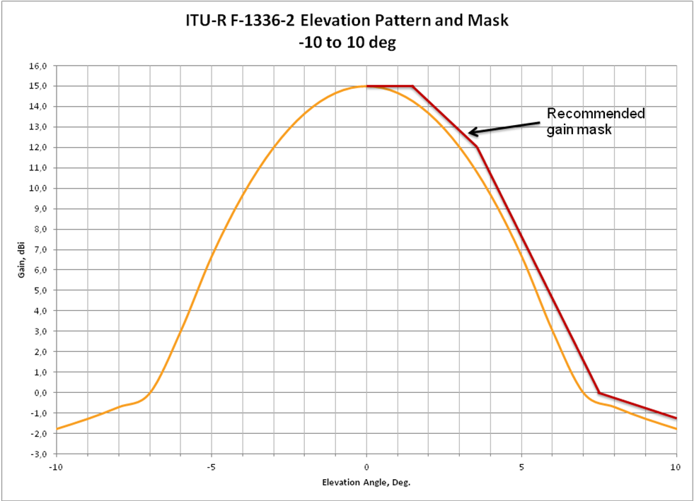
1d: Recommended BS Antenna Elevation Mask [MASPs]
15 dBi sector antenna
Azimuth 120 degrees
Elevation as shown →

Slide 11
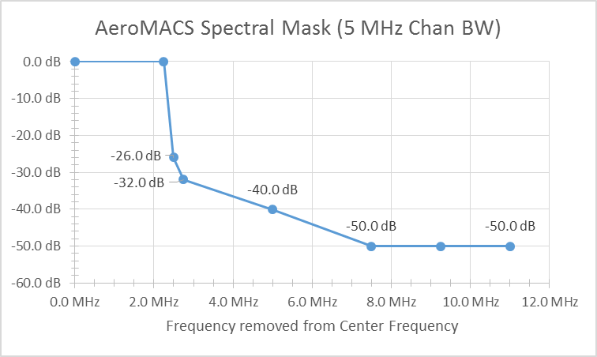
1e: AeroMACS Spectral Mask
Per: MOPS and SARPs

Slide 12
2. Eligible Licensees/Users
Potential Licensees
Network Access Provider (NAP) or,
Aeronautical Communication or,
Airport Operator or,
FAA
Users
FAA
TSA or local authorized Security Organization
Airport Operator including authorized sub-contractors
Airline Carriers (passenger and cargo)

Slide 13
3. Process for Channel Access
Advanced security measures (PKMv2) will prevent unauthorized access to the AeroMACS network
AeroMACS SHALL support Quality of Services (QoS) and Class of Service (CoS)
Ensures critical services get appropriate priority access to channel capacity and ensures each authorized user has adequate access

Slide 14
4. Federal vs. Non-Federal Users
Federal Users
FAA, TSA
Non-Federal Users
Airline Carriers
Medium & large hubs will have multiple commercial passenger & cargo carriers
Airport Operator
Local municipality, port authority, private airport owner, law enforcement, authorized sub-contractors such as fueling, catering services, etc.

Slide 15
5. Services & Applications
Data and Video will be primary, voice will be secondary
Authorized services fall into 5 domains:
Air Traffic Management (ATM)/Air Traffic Control (ATC)
Aeronautical Information Services and Meteorological Data (AIS/MET)
Aircraft Owner/Operator
Airport Authority
Airport Infrastructure
Some examples on next slide

Slide 16
5. Services & Applications (cont.)
Enhanced ATM is essential for minimizing “Taxi-out” times (significant financial benefit)
Can expect growth in video surveillance for enhanced airport safety and security
Capacity permitting, other lower priority applications may include the uploading of a/c entertainment services, etc.

Slide 17
6. Geographical Coverage Limits
AeroMACS MUST provide connectivity anywhere on the airport surface where aircraft are located. This includes two airport domains:
Runway and Taxiway areas
Gate and/or Ramp areas
AeroMACS coverage will not, intentionally, spill over to areas beyond airport surface. Exceptions for security purposes, may include:
Non-aeronautical airport-controlled areas, such as long & short term parking areas, shuttle bus routes, maintenance areas, etc.

Slide 18
Concluding Remarks
AeroMACS is a proven technology based on numerous trials and test-beds over the past several years
Large airport hubs (DFW for one) are interested in moving forward with “Standalone Applications Phase” (MLAT, WOI, etc.)
AeroMACS will be one of the key enablers for “NextGen,” a high priority congressionally approved and funded program

Slide 19
Relevant References & Standards
IEEE Std 802.16™-2009 (Revision of IEEE Std 802.16-2004) IEEE Standard for Local and metropolitan area networks Part 16: Air Interface for Broadband Wireless Access Systems 29 May 2009
WMF-T32-001-R010v09 - WiMAX Forum® Network Architecture -Architecture Tenets, Reference Model and Reference Points Part 0 - Release 1.0
WiMAX Forum Network Architecture (Stage 2: Architecture Tenets, Reference Model and Reference Points) [Part 1] WMF-T32-002-R010v05 (2009-03-19)
MOPS: Minimum Operational Performance Standards (MOPS) For the Aeronautical Mobile Airport Communication System (AeroMACS) - RTCA
MASPs: MINIMUM AVIATION SYSTEM PERFORMANCE STANDARDS For ENHANCED VISION SYSTEMS, SYNTHETIC VISION SYSTEMS, COMBINED VISION SYSTEMS And ENHANCED FLIGHT VISION SYSTEMS The European Organisation for Civil Aviation Equipment L’Organisation Européenne pour l’Equipement de l’Aviation Civile, ED-179, December, 2008
SARPs: Standards and Recommended Practices, ACP SWG N1/11 WP 13, INTERNATIONAL STANDARDS AND RECOMMENDED PRACTICES AERONAUTICAL TELECOMMUNICATIONS ANNEX 10 TO THE CONVENTION ON INTERNATIONAL CIVIL AVIATION VOLUME III - COMMUNICATION SYSTEMS

